Slide 1
Unit-2 Physical Layer and Media
Prepared by: Sushant bhattarai

Slide 2
Analog and Digital
Analog and Digital Data
Data can be analog or digital.
The term analog data refers to information that is continuous digital data refers to information that has discrete states.
Analog data, such as the sounds made by a human voice, take on continuous values
Digital data take on discrete values. For example, data are stored in computer memory in the form of 0s and 1s.

Slide 3
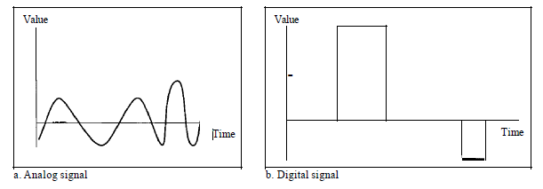
Analog and Digital
Analog and Digital signal
An analog signal has infinitely many levels of intensity over a period of time. As the wave moves from value A to value B, it passes through and includes an infinite number of values along its path.
A digital signal, on the other hand, can have only a limited number of defined values. Although each value can be any number, it is often as simple as 1 and 0.

Slide 4
Periodic and Non-periodic signals
Both analog and digital signals can take one of two forms: periodic or nonperiodic(aperiodic).
A periodic signal completes a pattern within a measurable time frame, called a period, and repeats that pattern over subsequent identical periods. The completion of one full pattern is called a cycle.
A nonperiodic signal changes without exhibiting a pattern or cycle that repeats over time.
In data communications, we commonly use periodic analog signals and nonperiodic digital signals.

Slide 5
Transmission Impairment
Signals travel through transmission media, which are not perfect. The imperfection causes signal impairment(the signal at the beginning of the medium is not the same as the signal at the end of the medium).
Three causes of impairment are attenuation, distortion, and noise.

Slide 6
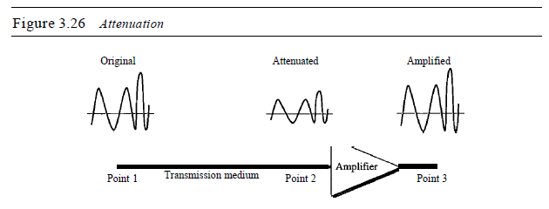
Attenuation
Attenuation means a loss of energy.
When a signal, simple or composite, travels through a medium, it loses some of its energy in overcoming the resistance of the medium.
That is why a wire carrying electric signals gets warm, if not hot, after a while. Some of the electrical energy in the signal is converted to heat.

Slide 7
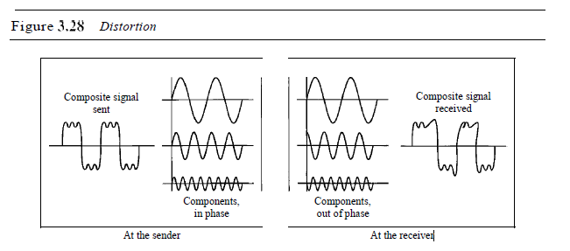
Distortion
Distortion means that the signal changes its form or shape.
Distortion can occur in a composite signal made of different frequencies. Each signal component has its own propagation speed through a medium and, therefore, its own delay in arriving at the final destination.
Differences in delay may create a difference in phase if the delay is not exactly the same as the period duration.

Slide 8
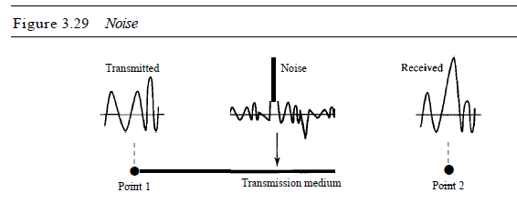
Noise
Noise is any unwanted or interfering signal that affects the quality and reliability of digital communication systems. It can originate from various sources, both internal and external, and can have different effects on the transmitted or received data.
Several types of noise, such as thermal noise, induced noise, crosstalk, and impulse noise, may corrupt the signal.

Slide 9

Signal to Noise Ratio(SNR)
SNR is actually the ratio of what is wanted (signal) to what is not wanted (noise).
A high SNR means the signal is less corrupted by noise; a low SNR means the signal is more corrupted by noise.
Mathematically,
$$SNR=\frac{Average signal Power}{Average Noise Power}$$
We need to consider the average signal power and the average noise power because these may change with time
Because SNR is the ratio of two powers, it is often described in decibel units, ${SNR}_{dB}$, defined as
$${SNR}_{dB}={10log}_{10}SNR$$

Slide 10
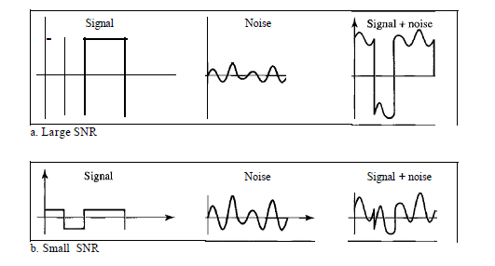
SNR

Slide 11

Numerical
The power of a signal is 10 mW and the power of the noise is 1 µW; what are the values of SNR and ${SNR}_{dB}$?
Solution: Given, Average signal Power=10mW=10×${10}^{3}µW$
Average Noise Power=1$µW$
The values of SNR and ${SNR}_{dB}$can be calculated as follows:
SNR = $\frac{Average signal Power}{Average Noise power}$
SNR = $\frac{10000}{1}$ =10000
${SNR}_{dB}={10log}_{10}SNR$
= ${10log}_{10}10000$
=40

Slide 12
Data rate limits
A very important consideration in data communications is how fast we can send data, in bits per second. over a channel. Data rate depends on three factors:
The bandwidth available
The level of the signals we use
The quality of the channel (the level of noise)
Two theoretical formulas were developed to calculate the data rate:
Nyquist for a noiseless channel
Shannon for a noisy channel.

Slide 13

Noiseless channel: Nyquist Bit rate
For a noiseless channel, the Nyquist bit rate formula defines the theoretical maximum bit rate
BitRate = 2 x bandwidth x ${10log}_{2}L$
where, bandwidth is the bandwidth of the channel,
L is the number of signal levels used to represent data BitRate is the bit rate in bits per second.
Note: Numerical already done in class

Slide 14

Noisy Channel: Shannon Capacity
We cannot have a noiseless channel; the channel is always noisy.
In 1944, Claude Shannon introduced a formula, called the Shannon capacity, to determine the theoretical highest data rate for a noisy channel:
Capacity =bandwidth X $\log_{2}$ (1 +SNR)
where, bandwidth is the bandwidth of the channel,
SNR is the signal-to-noise ratio
capacity is the capacity of the channel in bits per second.
Note: Numerical already done in class

Slide 15
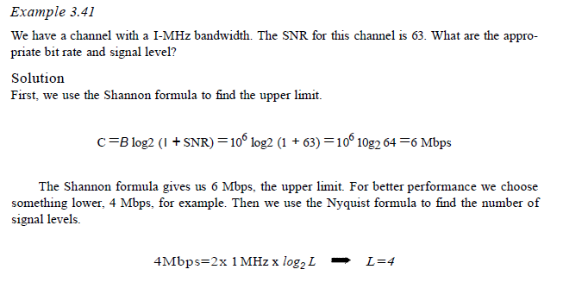
Numerical(Something new)

Slide 16
Performance
One important issue in networking is the performance of the network
There are various factors that determines the performance of a network. Some of them are listed below:
Bandwidth
Latency
Throughput
Jitter

Slide 17
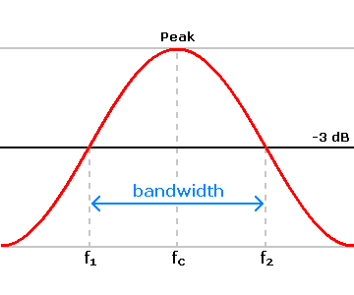
Bandwidth
Bandwidth specifically refers to the capacity at which a network can transmit data.
The term Bandwidth can be used in two different contexts with two different measuring values: bandwidth in hertz and bandwidth in bits per second.
Bandwidth in hertz:
Bandwidth in hertz is the range of frequencies contained in a composite signal or the range of frequencies a channel can pass. For example, we can say the bandwidth of a subscriber telephone line is 4 kHz.
Bandwidth in bps:
The term bandwidth can also refer to the number of bits per second that a channel, a link, or even a network can transmit.

Slide 18
Throughput
The throughput is a measure of how fast we can actually send data through a network.
Bandwidth in bits per second and throughput seem the same, they are different the bandwidth is a potential measurement of a link; the throughput is an actual measurement of how fast we can send data.
For example, we may have a link with a bandwidth of 1 Mbps, but the devices connected to the end of the link may handle only 200 kbps.

Slide 19
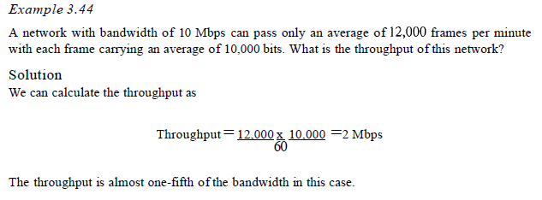
Throughput(Numerical)

Slide 20

Latency
The latency or delay defines how long it takes for an entire message to completely arrive at the destination from the time the first bit is sent out from the source.
We can say that latency is made of four components: propagation time, transmission time, queuing time and processing delay.
Propagation time
Propagation time measures the time required for a bit to travel from the source to the destination.
The propagation time is calculated by dividing the distance by the propagation speed.
$Propagation time=\frac{Distance }{Propagation speed}$
Latency =propagation time +transmission time +queuing time + processing delay

Slide 21
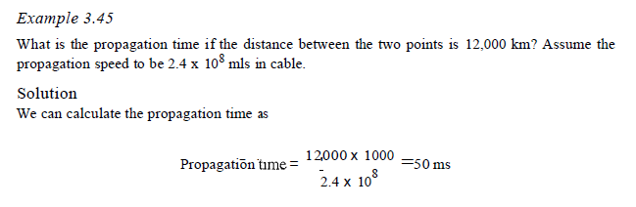
Latency
Numerical

Slide 22

Latency
Transmission Time
The time between the transmission of first bit by the sender and the arrival of last bit at the destination is known as transmission time.
Time between the first bit leaving the sender and the last bit arriving at the receiver. The first bit leaves earlier and arrives earlier; the last bit leaves later and arrives later.
The time required for transmission of a message depends on the size of the message and the bandwidth of the channel.
$$Transmission time=\frac{Message Size }{Bandwidth}$$

Slide 23
Latency
Queuing time
The third component in latency is the queuing time, the time needed for each intermediate or end device to hold the message before it can be processed.
The queuing time is not a fixed factor; it changes with the load imposed on the network. When there is heavy traffic on the network, the queuing time increases
Propagation delay
Propagation delay is the amount of time required for a signal to be received after it has been sent.
It is caused by the time it takes for the signal to travel through a medium.

Slide 24
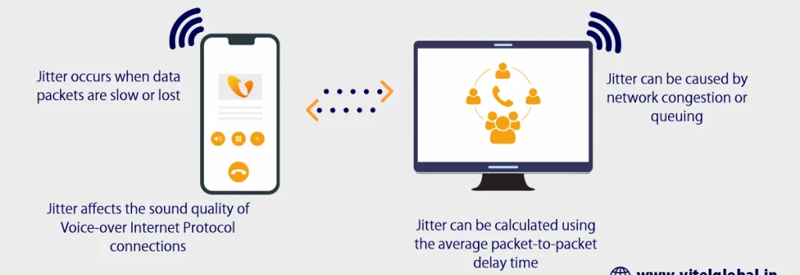
Jitter
Jitter is a problem if different packets of data encounter different delays and the application using the data at the receiver site is time-sensitive (audio and video data, for example).
If the delay for the first packet is 20 ms, for the second is 45 ms, and for the third is 40 ms, then the real-time application that uses the packets endures jitter.

Slide 25
Conversion(Digital to digital)
We can represent digital data by using digital signals.
The conversion involves three techniques:
Line coding
Block coding
Scrambling

Slide 26
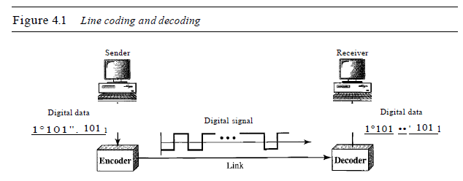
Line Coding
Line coding is the process of converting digital data to digital signals.
We assume that data, in the form of text, numbers, graphical images, audio, or video, are stored in computer memory as sequences of bits.
Line coding converts a sequence of bits to a digital signal.

Slide 27
Line encoding Schemes
We can roughly divide line encoding into five different schemes
Unipolar
Polar
Bipolar
Multilevel
Multitransition

Slide 28
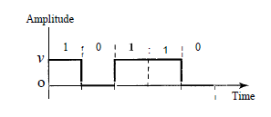
Unipolar
In a unipolar scheme, all the signal levels are on one side of the time axis, either above or below.
NRZ (Non-Return-to-Zero) Traditionally, a unipolar scheme was designed as a non-return-to-zero (NRZ) scheme in which the positive voltage defines bit 1 and the zero voltage defines bit 0.
It is called NRZ because the signal does not return to zero at the middle of the bit.

Slide 29
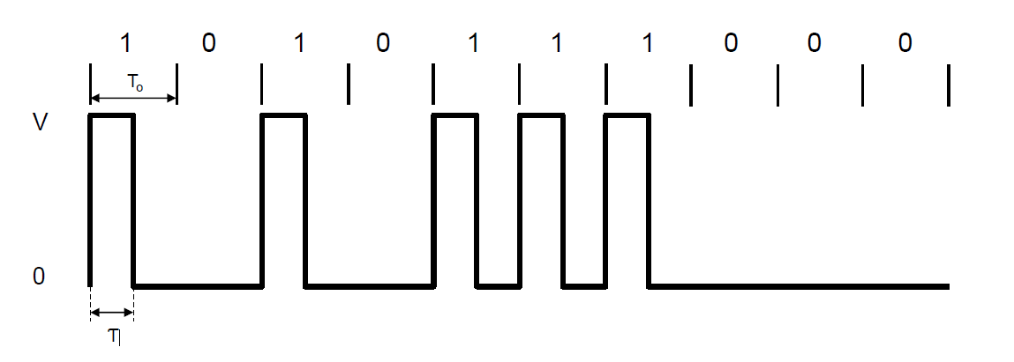
Unipolar
RZ(Return-to-Zero)

Slide 30
Polar
In polar scheme, the voltages are on the both sides of the time axis. For example, the voltage level for 0 can be positive and the voltage level for 1 can be negative.
NRZ-L(Non-Return-to-Zero): In polar NRZ encoding, we use two levels of voltage amplitude.
We can have two versions of polar NRZ: NRZ-L and NRZ-I.
NRZ-L (NRZ-Level), the level of the voltage determines the value of the bit. For instance in the example below negative voltage level represents binary value 1 and positive voltage level represents binary value 0.
In the second variation, NRZ-I (NRZ-Invert), the change or lack of change in the level of the voltage determines the value of the bit. If there is no change, the bit is 0; if there is a change, the bit is 1.

Slide 31
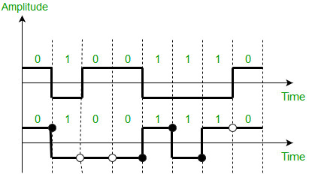
Polar
Example: Data = 01001110.

Slide 32
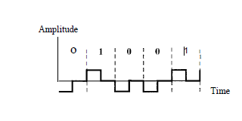
Polar
RZ(Return-to-Zero)
The signal changes not between bits but during the bit. In this scheme signal goes to 0 in the middle of each bit. It remains there until the beginning of the next bit.

Slide 33
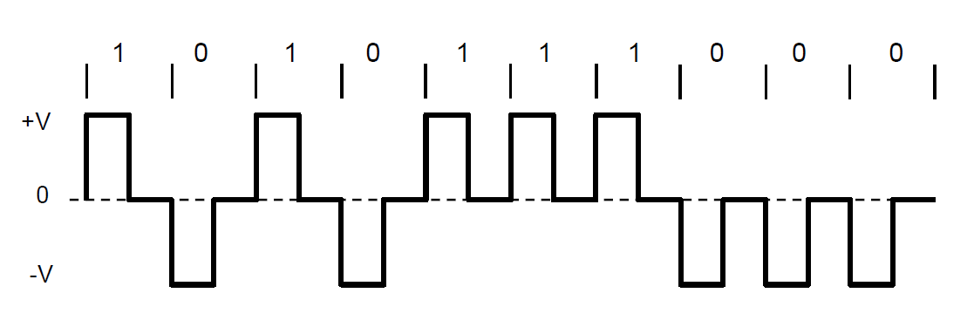
Polar (RZ)

Slide 34
Biphase : Manchester and Differential Manchester
Manchester:
In Manchester encoding, the duration of the bit is divided into two halves.
The voltage remains at one level during the first half and moves to the other level in the second half.
The transition at the middle of the bit provides synchronization.
Differential Manchester:
There is always a transition at the middle of the bit, but the bit values are determined at the beginning of the bit.
If the next bit is 0, there is a transition; if the next bit is 1, there is none.

Slide 35
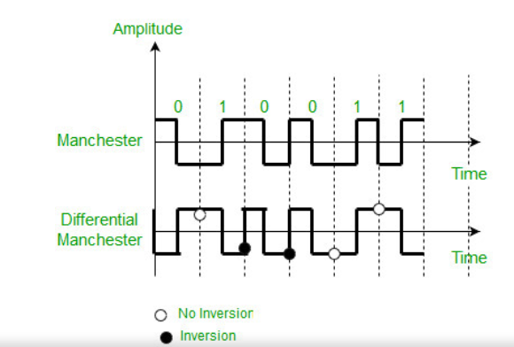
Example Manchester and Differential Manchester

Slide 36
Analog-to-Digital Conversion
Sometime it might be necessary to signal generated as analog to be converted into digital as it is today’s tendency to do so.
For example the analog signal created by a microphone must be converted into digital signal for further processing(autotune).
There are generally two techniques to do so. They are:
Pulse Code Modulation(PCM)
Delta Modulation(DM)
After the digital data are created (digitization), we can use one of the techniques to convert the digital data to a digital signal.

Slide 37
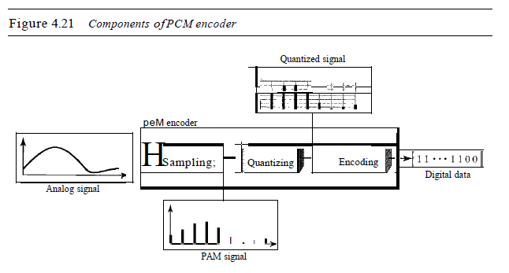
PCM
The most common technique to change an analog signal to digital data (digitization) is called pulse code modulation (PCM). A PCM encoder has three processes that is listed below:
The analog signal is sampled.
The sampled signal is quantized.
The quantized values are encoded as streams of bits

Slide 38
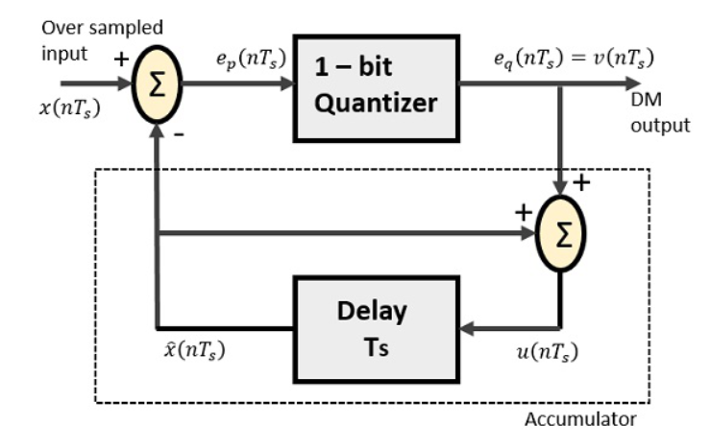
DM
PCM is a very complex technique. Other techniques have been developed to reduce the complexity of PCM. The simplest is delta modulation.
PCM finds the value of the signal amplitude for each sample; DM finds the change from the previous sample.

Slide 39
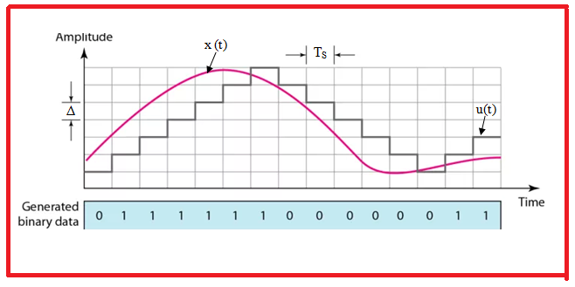
DM

Slide 40
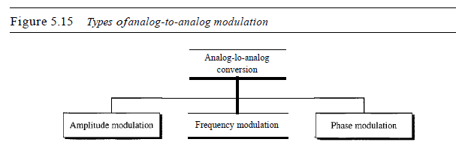
Analog to Analog Conversion
Analog-to-analog conversion, or analog modulation, is the representation of analog information by an analog signal.

Slide 41
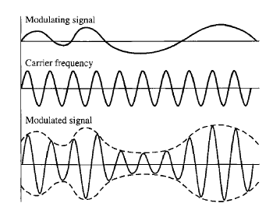
AM
In AM transmission, the carrier signal is modulated so that its amplitude varies with the changing amplitudes of the modulating signal. The frequency and phase of the carrier remain the same
only the amplitude changes to follow variations in the information.

Slide 42
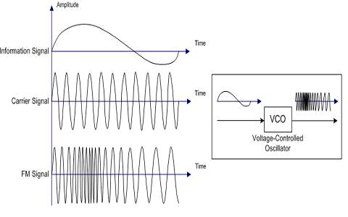
FM
In FM transmission, the frequency of the carrier signal is modulated to follow the changing voltage level (amplitude) of the modulating signal.
The peak amplitude and phase of the carrier signal remain constant, but as the amplitude of the information signal changes, the frequency of the carrier changes correspondingly.

Slide 43
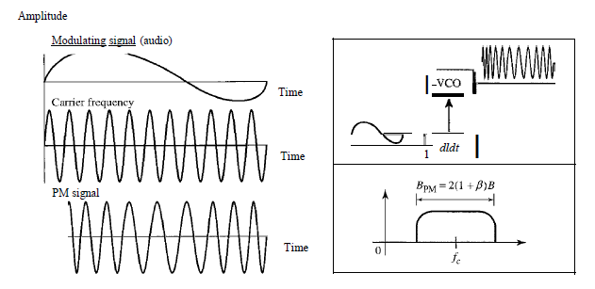
PM
In PM transmission, the phase of the carrier signal is modulated to follow the changing voltage level (amplitude) of the modulating signal.
The peak amplitude and frequency of the carrier signal remain constant, but as the amplitude of the information signal changes, the phase of the carrier changes correspondingly.

Slide 44
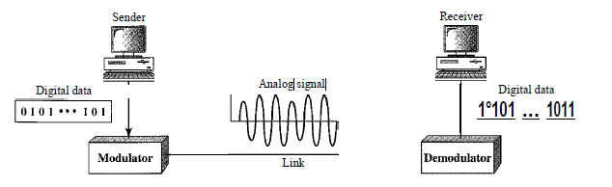
Digital to Analog Conversion
Digital-to-analog conversion is the process of changing one of the characteristics of an analog signal based on the information in digital data.
Figure below shows the relationship between the digital information, the digital-to-analog modulating process, and the resultant analog signal.

Slide 45
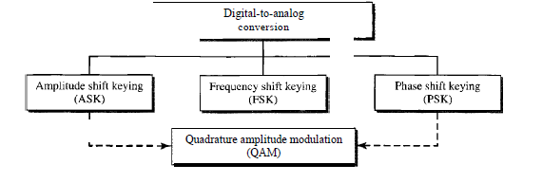
Types of digital to analog conversion

Slide 46
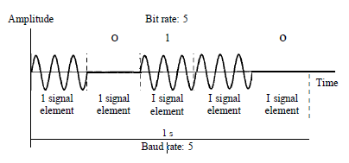
Amplitude Shift Keying(ASK)
In amplitude shift keying, the amplitude of the carrier signal is varied to create signal elements. Both frequency and phase remain constant while the amplitude changes.
Binary Amplitude Shift Keying(BASK):
We can have several levels (kinds) of signal elements, each with a different amplitude, ASK is normally implemented using only two levels.
This is referred to as binary amplitude shift keying or on-off keying (OOK). The peak amplitude of one signal level is 0; the other is the same as the amplitude of the carrier frequency.

Slide 47
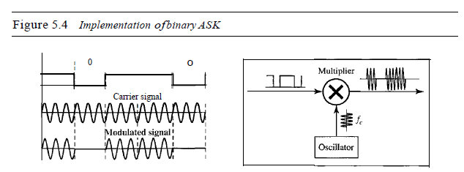
Binary ASK

Slide 48
Frequency Shift Keying(FSK)
In frequency shift keying, the frequency of the carrier signal is varied to represent data.
The frequency of the modulated signal is constant for the duration of one signal element, but changes for the next signal element if the data element changes.
Both peak amplitude and phase remain constant for all signal elements
Binary FSK:
One way to think about binary FSK (or BFSK) is to consider two carrier frequencies.
In Figure 5.6, we have selected two carrier frequencies, f1 and12.
We use the first carrier if the data element is 0; we use the second if the data element is 1.

Slide 49
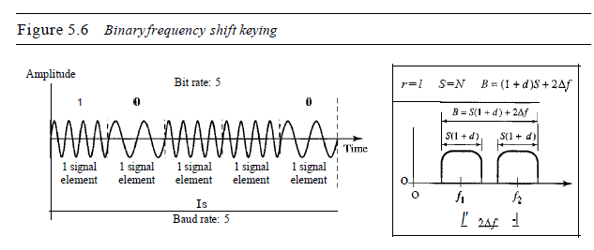
Binary FSK

Slide 50
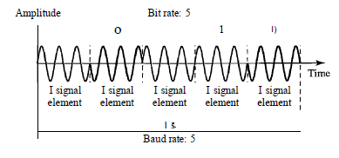
Phase Shift Keying
In phase shift keying, the phase of the carrier is varied to represent two or more different signal elements.
Both peak amplitude and frequency remain constant as the phase changes.
Today, PSK is more common than ASK or FSK.
Binary PSK:
The simplest PSK is binary PSK, in which we have only two signal elements, one with a phase of 0°, and the other with a phase of 180°. Figure below gives a conceptual view of PSK.

Slide 51
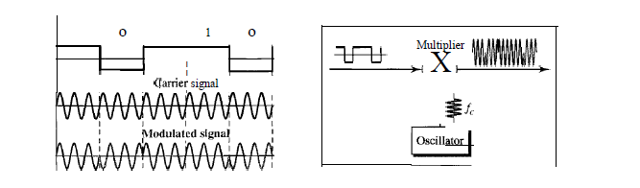
Phase Shift Keying
Implementation of BPSK

Slide 52
Phase Shift Keying
Quadrature PSK
The simplicity of BPSK enticed designers to use 2 bits at a time in each signal element, thereby decreasing the baud rate and eventually the required bandwidth.
The scheme is called quadrature PSK or QPSK because it uses two separate BPSK modulations.
The incoming bits are first passed through a serial-to-parallel conversion that sends one bit to one modulator and the next bit to the other modulator.

Slide 53
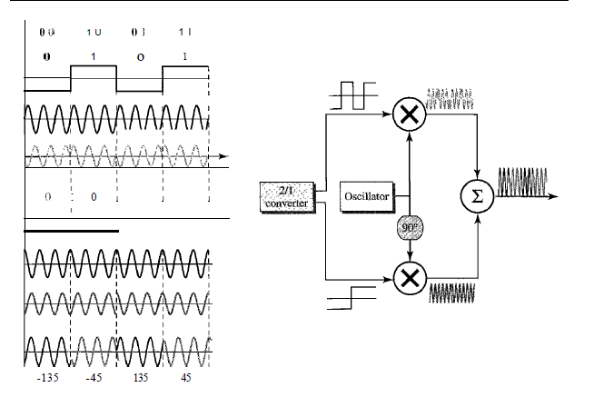
QPSK

Slide 54
Transmission Media
61
◆ The wires, cables, and other means through which data travels from its source to destination.
◆ Often called communication media.

Slide 55
Types of Transmission media
62
◆ Guided/Bounded/Wired Transmission Media
◆ Unguided/Unbounded/Wireless Transmission Media

Slide 56
Guided Transmission Media
63
◆ Twisted Pair Cable
◆ STP(Shielded Twisted Pair)
◆ UTP( Unshielded Twisted Pair)
◆ Coaxial Cable
◆ Fiber Optics Cable

Slide 57
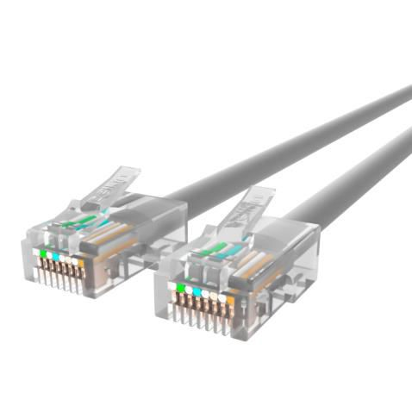
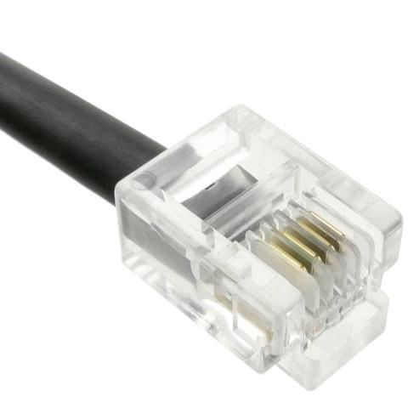
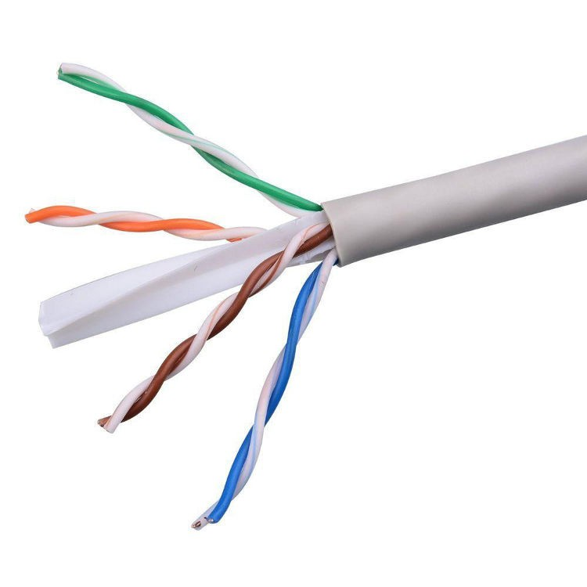
Twisted Pair Cable
64
◆ Oldest and most common transmission media
◆ Contains a pair of cable twisted with each other.
◆ Most commonly used in telephone and in LAN.
◆ Connected with the help of RJ-45 for LAN and RJ-11 for telephone.
RJ-45
Twisted Pair Cable
RJ-11

Slide 58
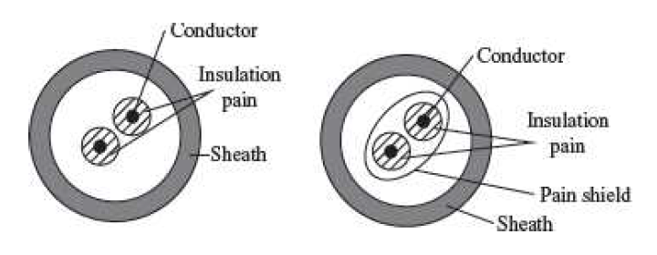
Twisted Pair Cable

Slide 59
Advantages of Twisted Pair Cable
65
◆ Light and thin so flexible to fit
◆ Cheaper than other cable
◆ Data transmission at high bandwidth for short distance

Slide 60
Disadvantages of Twisted Pair Cable
66
◆ Cannot be used for long distance transmission
◆ Slower rate of data transmission as compared to other cable
◆ Prone to noise
◆ Electric field and magnetic field can easily affect the transmission

Slide 61

UTP( Unshielded Twisted Pair)
67
◆ Most common twisted pair
◆ No extra covering
◆ Data transmission over a short distance
◆ Cheaper

Slide 62
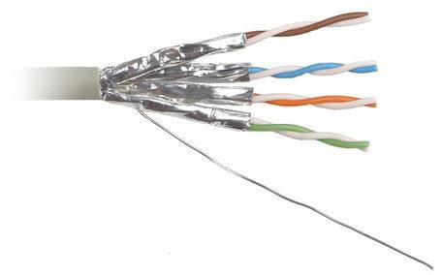
STP( Shielded Twisted Pair)
68
◆ Rarely used
◆ Extra covering with metal foil
◆ Data transmission over long range
◆ Expensive

Slide 63
Coaxial cable
69
◆ Carries data signal at higher frequency and faster speed
◆ Commonly used for transmission of signal in TV and broadband transmission.
◆ Transmit many signals at the same time
◆ Each signal is called a channel.
◆ Has very high bandwidth

Slide 64
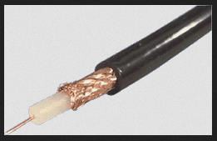
Coaxial cable
70
◆ Has a single copper conductor at its center.
◆ Plastic layer provides insulation between center conductor and a braided metal shield.
◆ Surrounded by an external insulation layer.
Coaxial cable

Slide 65
Advantages of Coaxial Cable
71
◆ Provides faster data transmission than twisted pair
◆ Data transmission over medium range.
◆ Easier to install , modify and manage the network

Slide 66
Disadvantages of Coaxial Cable
72
◆ Expensive than twisted pair cable
◆ Not appropriate for long distance transmission
◆ Rarely used at present for a computer network.

Slide 67
Fiber Optics
73
◆ Made up of glass or plastic
◆ Transmits signal in form of light.
◆ Can carry voice , video and data.
◆ Large bandwidth and carry signal for extremely long distance.
◆ Immune to electromagnetic interference
◆ Secure than other cables.

Slide 68
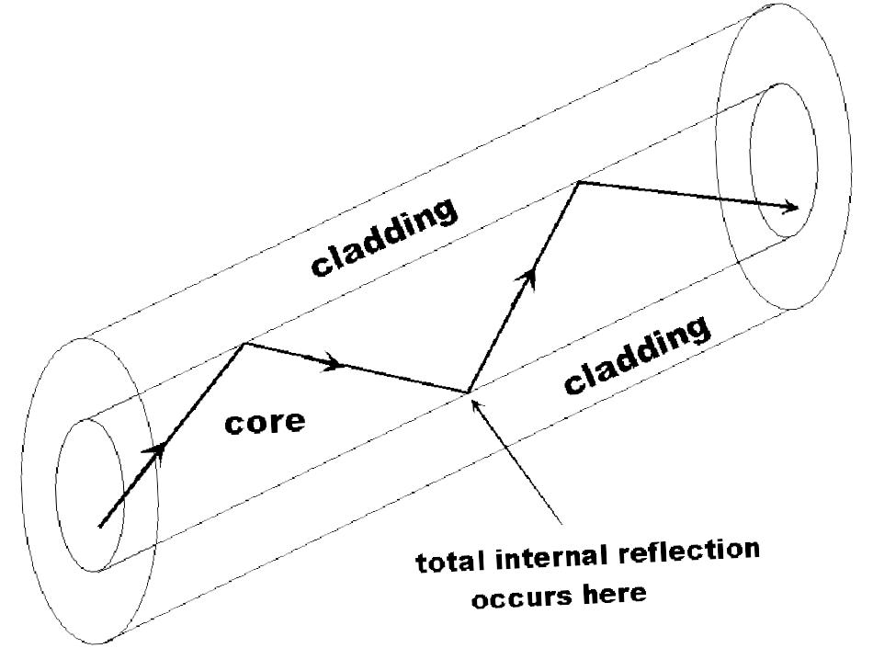
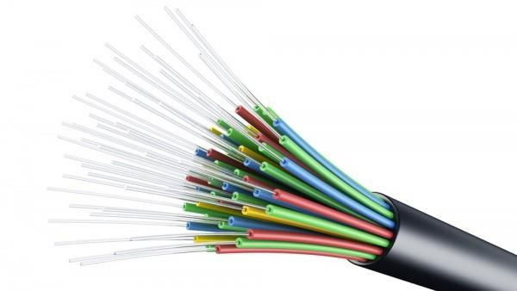
Fiber Optics
74
◆ Consist of glass core at the center
◆ Surrounded by several layers of protective materials.
◆ Cable itself is a core fiber surrounded by cladding
◆ LED send signal down the cable.
◆ A detector receives the signals & converts them back to electrical impulses
Optical fiber

Slide 69
Advantages of Fiber Optics
75
◆ Fastest data transmission than other transmission media.
◆ Can be used for both short and long distance transmission
◆ Error free highly secured transmission

Slide 70
Disadvantages of Optical Fiber
76
◆ Expensive and difficult to install
◆ Prone to damage
◆ Skilled technical manpower required to install

Slide 71
Unguided/Unbounded/Wireless Transmission Media
77
◆ Those transmission media that aren’t bounded by wire to send data
from source to destination is wireless transmission media.
◆ Data flow in atmosphere.

Slide 72
Types of Wireless Transmission Media
78
Microwave system
Radio Transmission
Infrared
Satellite Communication,etc.

Slide 73
Microwave System
79
Uses very high frequency radio signal to transmit data through the air.
Transmitter and receiver of a microwave system should be in LOS(Line of Sight) as it can’t be bend.
Transmitting and receiving antenna must be placed on some place at considerable height(buildings , top of hills , etc. )
Very long distance transmission isn’t possible.
In order to overcome LOS and short distance, repeater are used at intervals of 25 to 30 km apart.
Repeater receives the signal amplifies it and send it to the next tower.

Slide 74
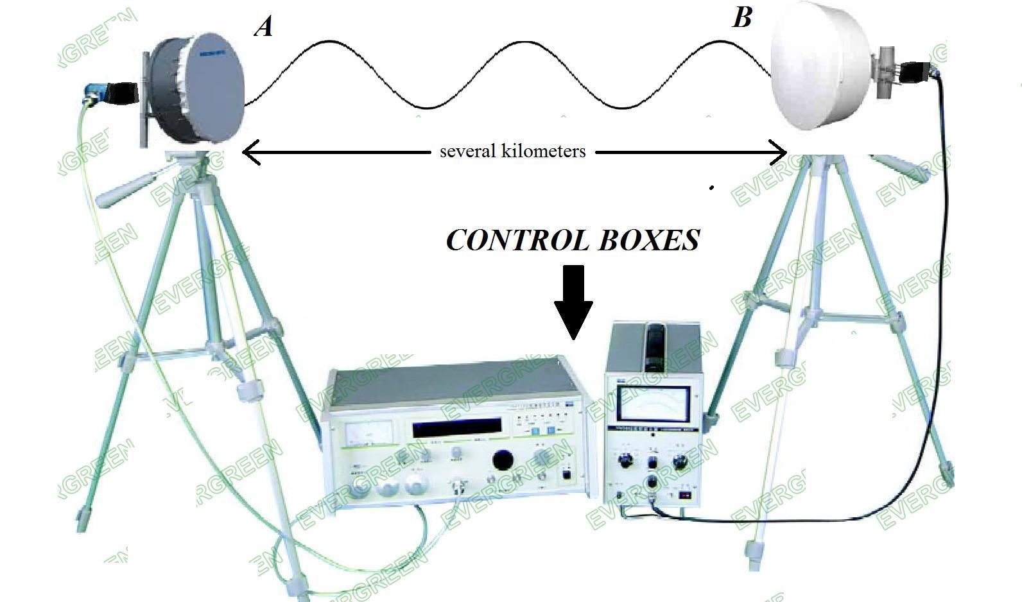
Microwave System
80
◆ Radio frequencies are used
Microwav e System

Slide 75

Radio Transmission
The electromagnetic radio waves that operate at the radio frequency are also used to transmit computer data. This transmission is also known as Radio Frequency (RF) transmission.
The computers using RF transmission do not require a direct physical connection like wires or cable.
Each computer attaches to an antenna hat can both send and receive radio transmission.

Slide 76
Satellite Communication
81
◆ Most common worldwide communication system at present.
◆ Uses satellite as a repeater.
◆ Have receiver and transmitter located in ground stations.
◆ Microwave signal is transmitted from a transmitter on earth to the satellite at space.
◆ Satellite amplifies the weak signal and transmits it back to the receiver.
◆ In order to cover large distance multiple satellite are used.

Slide 77
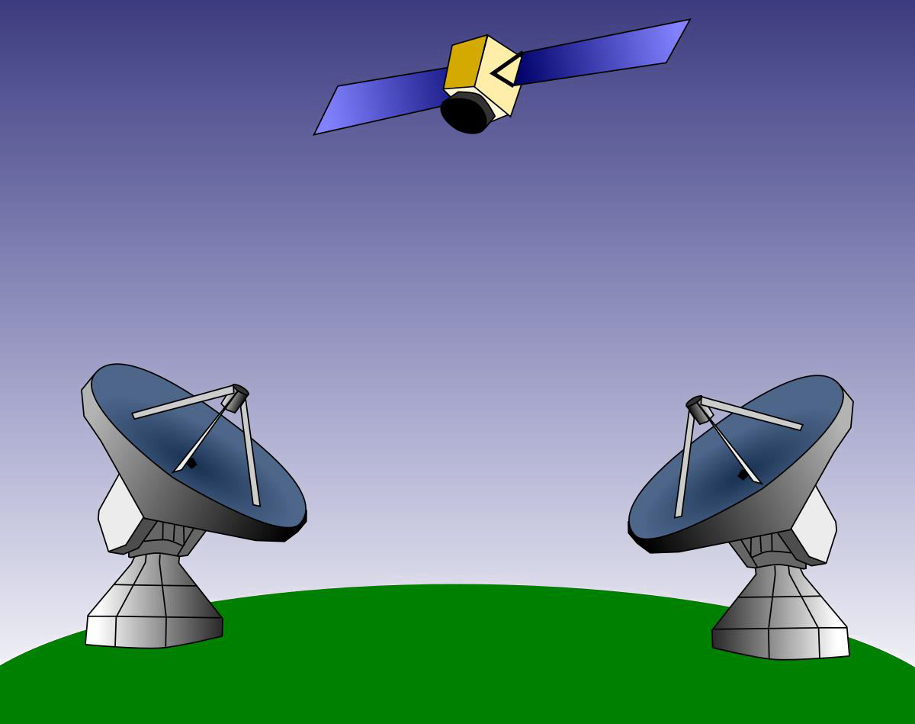
Satellite communication

Slide 78
Infrared
◆ Used for short range communication
◆ LOS is necessary
◆ High frequency signal
◆ Cannot penetrate walls. So prevents interference between systems.
◆ Mainly used in wireless mouse , remote control , etc
◆ Generally not used outside as sun’s infrared can interfere.

Slide 79
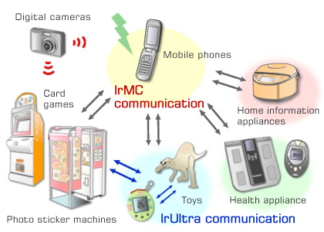
Infrared

Slide 80
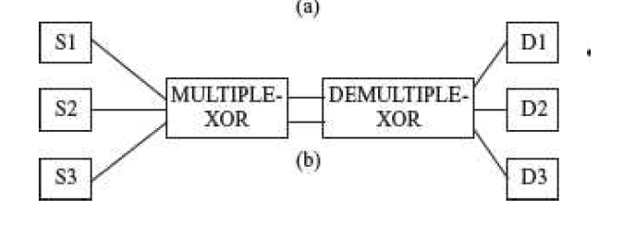
Multiplexing
Transmission medium have varying data carrying capacities.
To utilize the full capacity of the transmission medium, computer networks use separate channels that allow sharing of a single physical connection for multiple communication.
Multiple carrier signals are transmitted over the same medium at the same time and without interference from each other.
The combining of multiple signals into a form that can be transmitted over a single link of a communication medium is called multiplexing.
The three basic multiplexing techniques are
Frequency Division Multiplexing (FDM)
Time Division Multiplexing(TDM)
Wavelength Division Multiplexing (WDM).

Slide 81
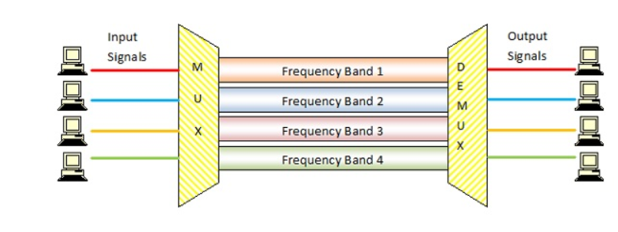
FDM(Frequency Division Multiplexing)
Frequency division multiplexing (FDM) is a technique of multiplexing which means combining more than one signal over a shared medium.
In FDM, the total bandwidth is divided to a set of frequency bands that do not overlap.
The frequency bands are separated from one another by strips of unused frequencies called the guard bands, to prevent overlapping of signals
FDM combines different carrier frequencies signals into a single signal of higher bandwidth. The bandwidth of the communication medium link carrying the combined signal is greater than the sum of the bandwidth of the individual signals that are combined.

Slide 82
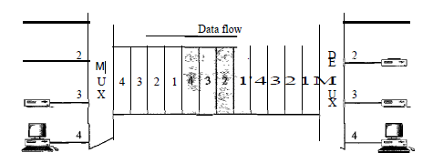
TDM(Time Division Multiplexing)
Each connection occupies a portion of time in the link.
This happens when the data transmission rate of media is greater than that of the source, and each signal is allotted a definite amount of time.
These slots are so small that all transmissions appear to be parallel.
In frequency division multiplexing all the signals operate at the same time with different frequencies, but in time-division multiplexing, all the signals operate with the same frequency at different times.
It is of two types:
Synchronous TDM
The time slots are pre-assigned and fixed. This slot is even given if the source is not ready with data at this time.
In this case, the slot is transmitted empty. It is used for multiplexing digitized voice streams.

Slide 83
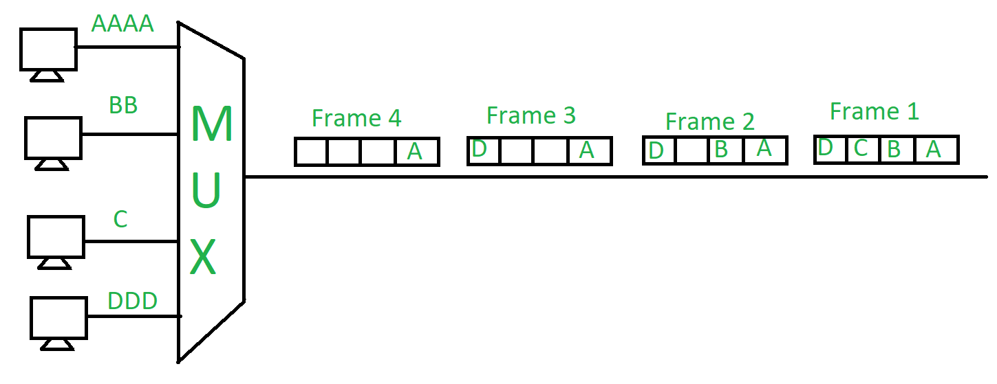
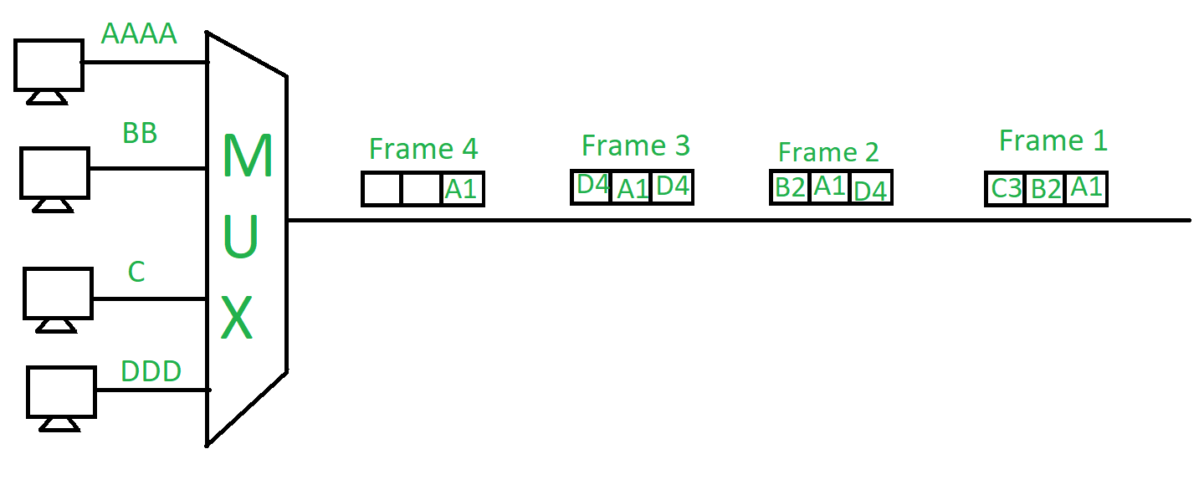
TDM
Asynchronous TDM
The slots are allocated dynamically depending on the speed of the source or their ready state.
It dynamically allocates the time slots according to different input channels’ needs, thus saving the channel capacity.
Fig: Synchronous TDM

Slide 84
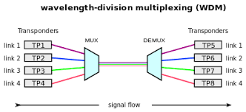
WDM(Wavelength Division Multiplexing
WDM is similar to FDM except that FDM involves electromagnetic spectrum below light and WDM involves light signals.
WDM uses very high frequencies
Wavelength division multiplexing (WDM) is a technique of multiplexing multiple optical carrier signals through a single optical fiber channel by varying the wavelengths of laser lights.
The optical signals from different sources or (transponders) are combined by a multiplexer, which is essentially an optical combiner. They are combined so that their wavelengths are different.
The combined signal is transmitted via a single optical fiber strand.
At the receiving end, a demultiplexer splits the incoming beam into its components and each of the beams is send to the corresponding receivers.

Slide 85
Switching
138
Aim of Data Communication and Networking is to facilitate the exchange of data such as audio, text or video between various points in the world.
This transfer of data takes place over the computer network over which the data travels smoothly.
For the delivery of data or information with the ease of accuracy various types of Switching Techniques are employed in the Data Communication and Networking

Slide 86
Types of Switching
139
Circuit Switching
Packet Switching
Message Switching

Slide 87
Circuit Switching
140
Circuit Switching is generally used in the public networks.
It come into existence for handling voice traffic in addition to digital data
Here the network connection allows the electrical current and the associated voice with it to flow in between the two respective users.
The end to end communication was established during the duration of call.
Here the routing decision is made when the path is set up across the given network.
After the link has been sets in between the sender and the receiver then the information is forwarded continuously over the provided link.

Slide 88
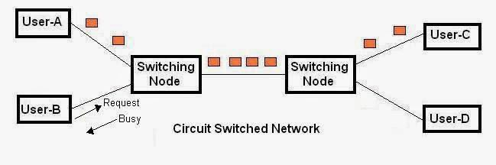
Circuit Switching
141

Slide 89
Advantages of Circuit Switching
It uses a fixed bandwidth.
A dedicated communication channel increases the quality of communication.
Data is transmitted with a fixed data rate.
No waiting time at switches.
Suitable for long continuous communication.

Slide 90
Disadvantages of Circuit Switching
A dedicated connection makes it impossible to transmit other data even if the channel is free.
Resources are not utilized fully.
The time required to establish the physical link between the two stations is too long.
As a dedicated path has to be established for each connection, circuit switching is more expensive.
Even if there is no transfer of data, the link is still maintained until it is terminated by users. By this channel remains ideal for a long time thereby making circuit switching inefficient.
Dedicated channels require more bandwidth.

Slide 91

Packet Switching
In Packet Switching, messages are broken up into packets
Each of which includes a header with source, destination and intermediate node address information.
Individual Packets in packet switching technique take different routes to reach their respective destination

Slide 92
Advantages of Packet Switching
Delay in delivery of packets is less, since packets are sent as soon as they are available.
Switching devices don’t require massive storage, since they don’t have to store the entire messages before forwarding them to the next node.
Data delivery can continue even if some parts of the network faces link failure. Packets can be routed via other paths.
It allows simultaneous usage of the same channel by multiple users.
It ensures better bandwidth usage as a number of packets from multiple sources can be transferred via the same link.

Slide 93
Disadvantages of Packet Switching
They are unsuitable for applications that cannot afford delays in communication like high quality voice calls.
Packet switching high installation costs.
They require complex protocols for delivery.
Network problems may introduce errors in packets, delay in delivery of packets or loss of packets. If not properly handled, this may lead to loss of critical information.

Slide 94
Message Switching
In Message Switching it is not necessary to established a dedicated path in between any two communication devices.
Each message is treated as an independent unit and includes its own destination source address by its own.
Each complete message is then transmitted from one device to another through internet work.
Each intermediate device receive the message and store it until the nest device is ready to receive it and then this message is forwarded to the next device.
For this reason a message switching network is sometimes called as
Store and Forward Switching.

Slide 95

Message Switching

